Slide 1


Online Antisemitism Before and After October 7 Workshop 1 Datathon & Machine Learning Competition Günther Jikeli, Daniel Miehling, and Damir Cavar Research Lab Social Media & Hate

Slide 2

The Places We Will Go Today
Welcome
What’s social media
What’s antisemitism
Results from our Research Lab
Observations after 10/7
Conclusions
Q&A
Breakout Rooms in Teams

Slide 3
To grasp online antisemitism, it's important to first have a basic understanding of how social media operates.

Slide 4

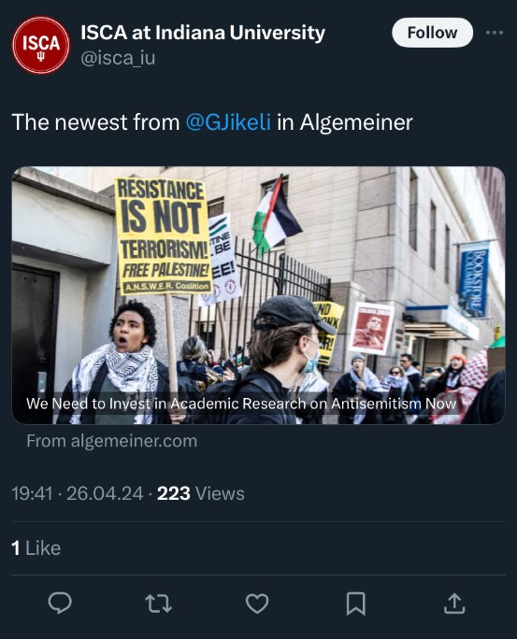
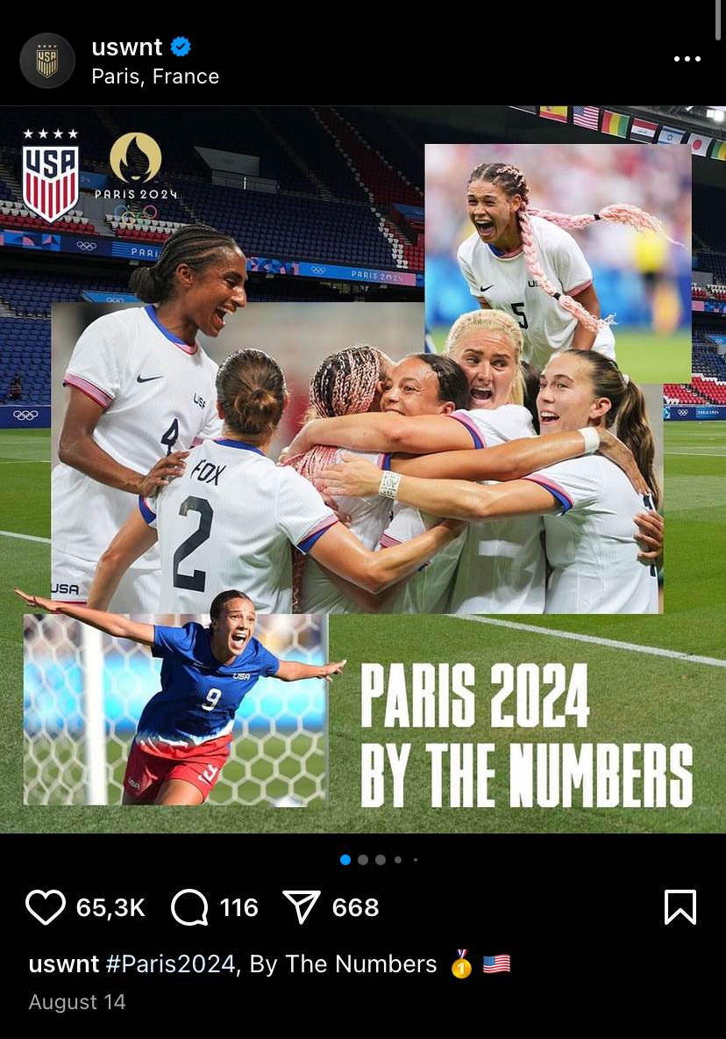
Different Platforms – Similar Features – Different Foci
TikTok: videos
X/Twitter: text
Instagram: images

Slide 5
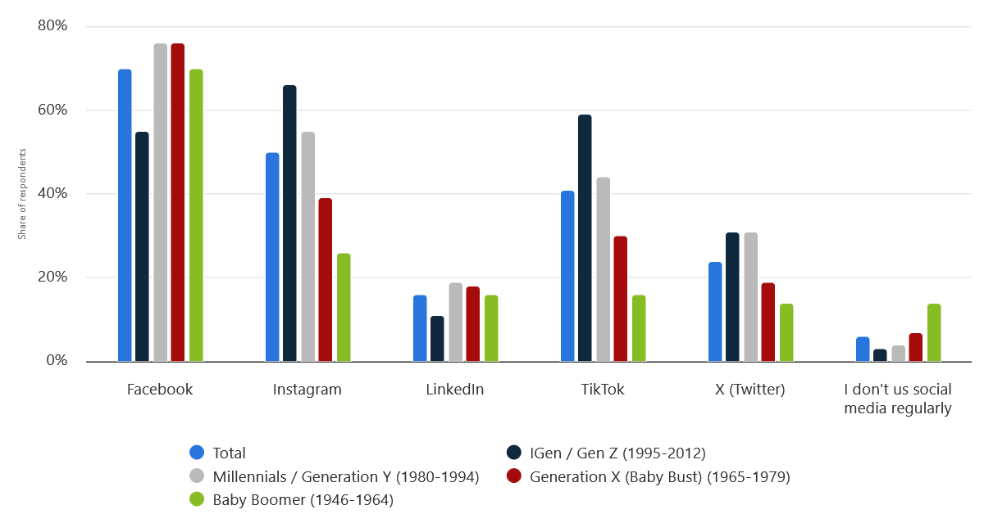
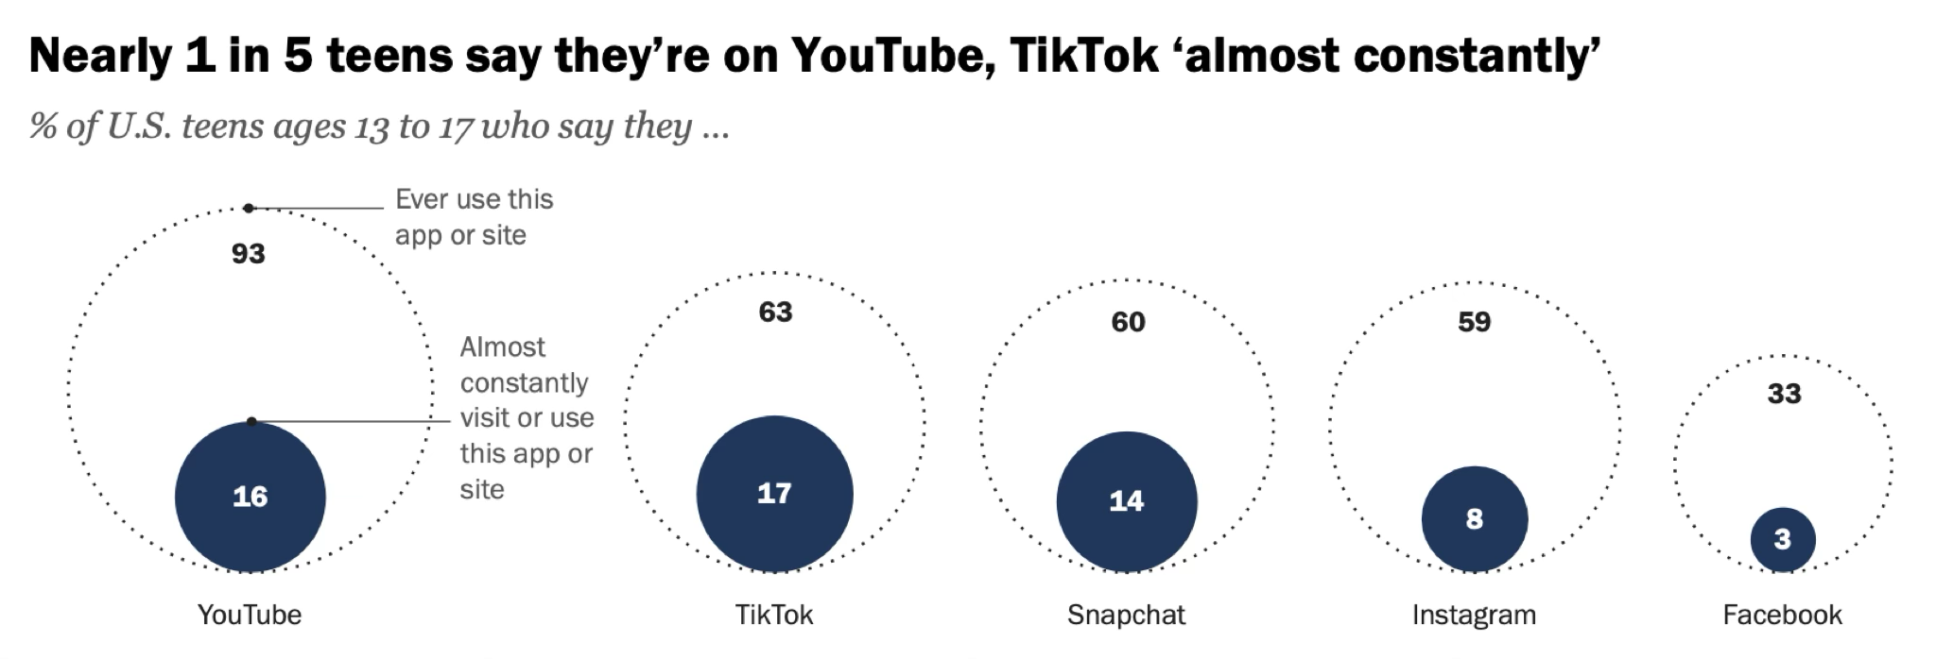
Social Media Usage in the U.S. 2024 Source: Statista

Slide 6
To identify antisemitism online, it's crucial to understand what it entails, including the stereotypes and tropes that have developed over more than 2000 years.

Slide 7

Religious tropes have been influential, and today, Christian and Islamic references can still serve as indicators or "whistleblowers" for antisemitism.
John 8:44

Slide 8
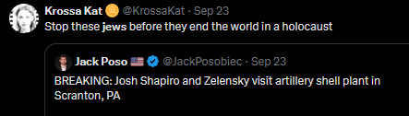
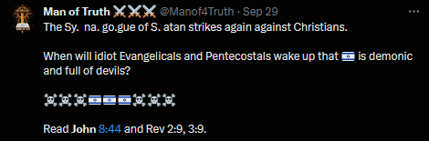
We need to know about the history of antisemitism to be able to identify antisemitism today

Slide 9
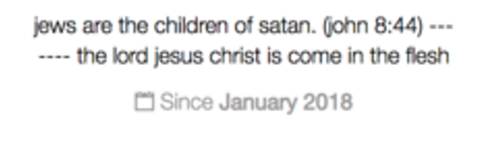
Notes:
9

Slide 10
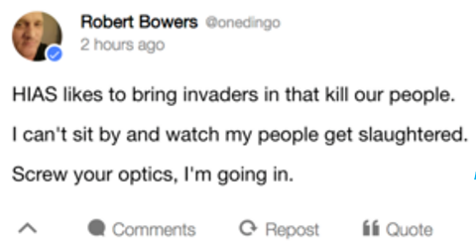
The terrorist who killed 11 people in 2018 at the Tree of Life Synagogue in Pittsburgh, PA was an active user of the social media platform Gab, where he became radicalized.
This is what he put in his bio on Gab
This is how he justified killing Jews
Hebrew Immigrant Aid Society
Notes:
10

Slide 11
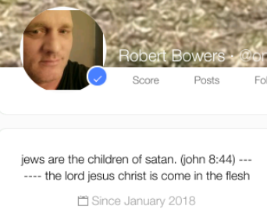
This is from the account in the New Testament of a heated dialogue between Jesus and Jews in Jerusalem. According to the story in John, people have been agitating and plotting against Jesus for some time. So Jesus reacts rather strongly and calls these agitators children of the devil.
Powerful Accusation in the Christian Tradition:
Jews are evil
Demonizing Jews
“Why do you not understand what I say? It is because you cannot accept my word. You are from your father the devil” John 8:43-44
However
"Those who cite John, saying that 'Jews are children of the devil,' ignore statements in John, like 'Salvation comes from the Jews.’”
Bible scholar professor H. Attrige

Slide 12
Dr. Gunther Jikeli, Sept. 3, 2024
Historical Period | New Accusations Against Jews
Early Christianity in the tradition of Judaism
Christianity separates from Judaism
Early Islam
Islamic conquests
Middle Ages Crusades
Middle Ages. Theological debates
Middle Ages. Increasing importance of finance
Black Death
Reconquista
Reformation
Enlightenment
Nationalism
Rapid global changes of societies
Nazism
Post-WWII
Targeting religion: Jews are evil, and Jews are enemies.
Delusional accusations (e.g. blood libel, responsible for Black Death) → pogroms.
Targeting “blood” and race → most extreme violence
Targeting Israel and the Memory of the Holocaust

Slide 13
Historical Period | Major real or perceived problems and ills of society | Accusations against Jews
Early Christianity in the tradition of Judaism | What is the true belief in the prophets and scripture? What about the covenant with God? | “Jews killed Jesus Christ.” → Jews reject truth and are evil. “Jews have not accepted the new covenant and are therefore condemned to be dispersed and live in misery.”
Christianity separates from Judaism | Forming a Christian identity and canon of scripture. | “Jews are the enemies of Christians.”
Early Islam | The Quran has many stories that are similar but somewhat different from stories in the Bible. | “Jews and Christians falsified sacred scripture.” → They are liars.
Islamic conquests | What to do with monotheistic minorities who do not convert? | Jews and Christians are religiously unclean (and should be separated and discriminated against)
Middle Ages, Crusades | Jerusalem must be liberated from the infidels by force. | → Served as justification for plunder and violence against Jews.
Middle Ages. Theological debates | Doctrine of the Eucharist (the belief that Jesus is present in the Eucharist, not merely symbolically or metaphorically) and thus Christians drink Jesus’ blood in the communion and eat his flesh. | “Jews desecrate the hosts and perform rituals with human blood.” “Jews abduct Christian children to perform rituals with human blood.”
Middle Ages. Increasing importance of finance | Financing becomes increasingly important. However, it is frowned upon and Jews are forced into this sector, exploiting their vulnerability (depts can be annulled by expulsing the Jews). | “Jews are greedy, immoral, and tight.”
Black Death | The inexplicable Plague | “Jews are responsible for the plague and poisoned wells.”
Reconquista | Spanish Inquisition: Heresy is the biggest threat to Christianity. (And even the “blood” has to be pure: "Limpieza de sangre“) | Invention of “Jewish blood.”
Reformation | True Christianity has to be defended against Papacy and other “enemies.” | “Jews are the enemies of Christians and cannot be converted.”
Enlightenment | Foundation of a new society and fight against the power of the Church and the aristocracy (= against the old order) | “Jews are backwards and ossified.” “Judaism is the source of the Church’s evil.”
Nationalism | Who is part of the nation? Who is not part of the nation? French model of the nation (all citizens born on French territory are French and equal) German model of the nation: ethnicity | French: Jews are not loyal citizens. They form a nation within the nation. German: Jews cannot be German by “race”
Rapid global changes of societies | Economic, technological, and social changes happen quickly without cohesive planning. New models of society emerge, such as liberalism, communism, capitalism, and socialism. | Jews are blamed for changes and ideologies of the opposite camp, allegedly ruling the world secretly.
Nazism | Strive for world dominance and homogenization of the German people | “Jews rule the world and are responsible for the decay of society.” -Everything evil is Jewish > Jews must be annihilated.
Post-WWII | Real and perceived ills of society and the world: From the political left: Wars, colonialism, human rights violations, racism. From the political right: Migration, liberalism, national history | -Israel/Jews are colonialists, warmongers, racist, white nationalist. - “Jews will not replace us.” Jews are responsible for liberalism (e.g. Soros is behind all liberal causes), Holocaust denial

Slide 14
Early Christianity
Emergence of Islam
Middle Ages
National Revolutions
French Revolution
(Failed) German Revolution
Russian Revolution
Nazism
After WWII
ACCUSATIONS
Jews killed Christ, Jews are/work with the Anti-Christ, “Judaization” of enemies.
Jews falsified the Scriptures and must be subdued to Islam.
Blood libel, well-poisoning (collectively responsible for epidemics)
Jews are not loyal citizens (“nation within the nation”), Jews don’t assimilate, Jews are greedy and cruel.
Jews cannot be Germans, they are fundamentally different and enemies of the German people, the “Jewish spirit” is bad for the world.
Jews are responsible for economic crises and conspire against Russia & the world.
“The Jews” are seen not only as evil but evil is seen as Jewish.
Jews misuse the memory of the Holocaust.
The Jewish State is evil and Jews are complicit.

Slide 15
Understanding this extensive reservoir of stereotypes and tropes allows our team of annotators to manually identify antisemitic themes in online messages.
Through intelligent sampling and extrapolation, we can then analyze trends and draw conclusions about changes over time.
Additionally, the annotated datasets can be utilized for the automatic detection of antisemitic messages using AI technology.
Our Methods

Slide 16
Definitions
All definitions have their limitations. The most widely used practical definition with examples is the Working Definition of the International Holocaust Remembrance Alliance (IHRA). However, a 1-page document cannot fully capture the complex historical and psychological origins of antisemitism. It can serve as a guideline. The IHRA Definition includes examples that can signal potential antisemitic intent. Since 10/7, three of these examples have become especially pertinent.
“Drawing comparisons of contemporary Israeli policy to that of the Nazis.”
“Denying the Jewish people their right to self-determination, e.g., by claiming that the existence of a State of Israel is a racist endeavor.”
“Holding Jews collectively responsible for actions of the state of Israel.”

Slide 18
Antisemitic Mobilization: from antisemitic tropes to endorsing violence
Misuse of the Holocaust to attack Jews
Mainstreaming of the accusation against Israel of genocide/ “holocaust against Palestinians”
Posts on the Holocaust trigger Nazi-Israel comparisons
Since 10/7

Slide 19
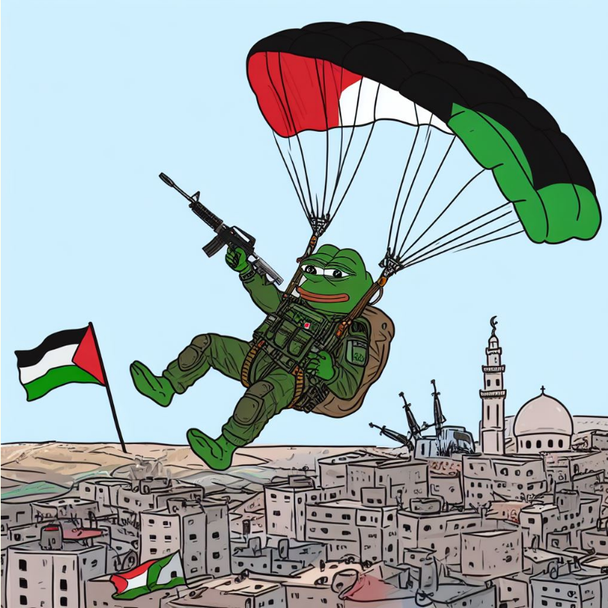

1) Endorsing violence against Jews and Israelis after 10/7
White Nationalist user on 4chan
“ITS HAPPENING!!!! BLM NIGGERS FULLY SUPPORT PALESTINE. JEWS SEETHING. IS IT OVER FOR JEWS NOW THAT LITERALLY EVERYONE BUT SOON-TO-BE-DEAD BOOMERS IS AGAINST THEM??”
University of Washington

Slide 20
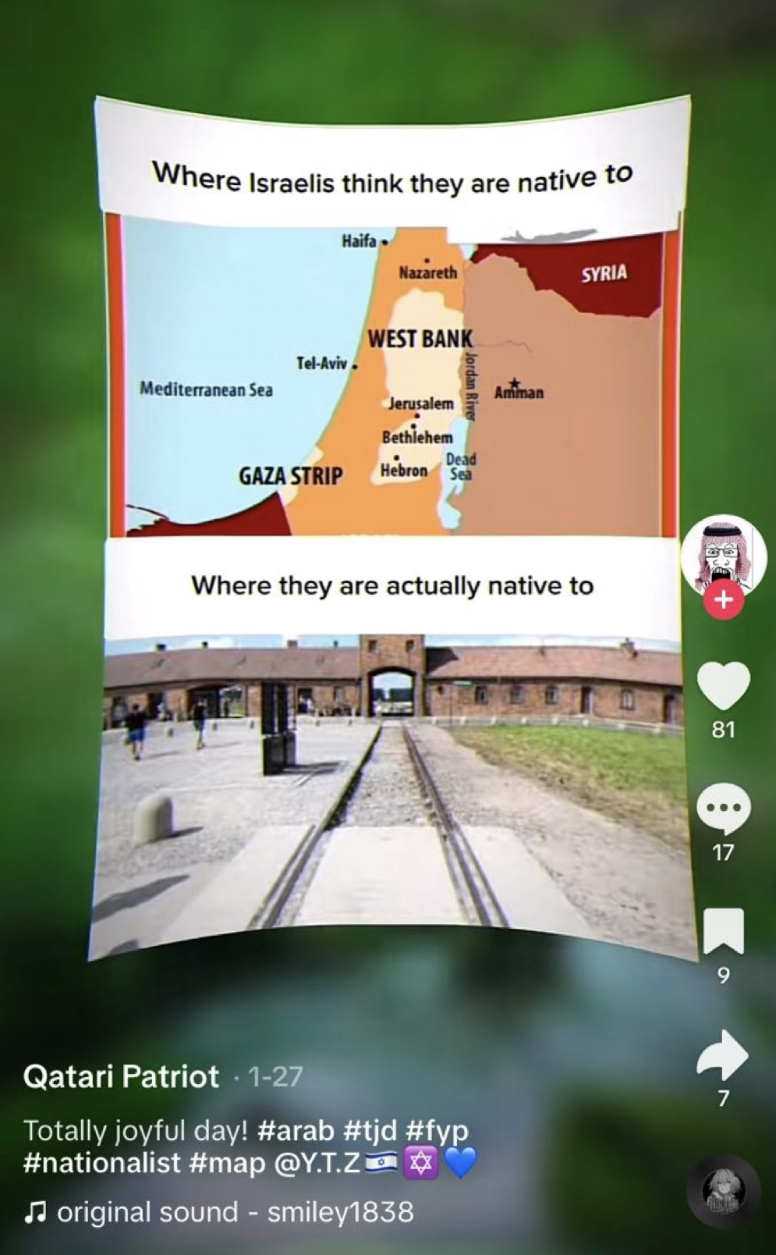
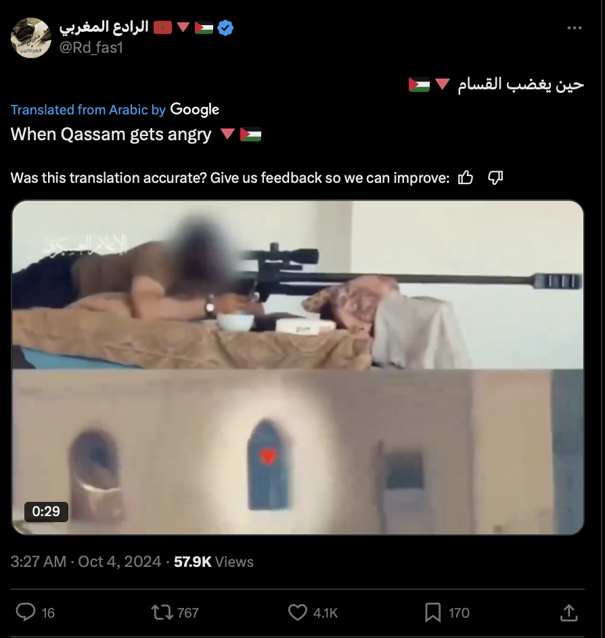
Dog whistles → Antisemitism behind 'harmless' words and emojis
Emojis:
🚿
🍪
🔻
TJD, 88, …
#wellwellwell
Austrian painter/👨‍🎨
Platform: X/Twitter
Platform: TikTok

Slide 21
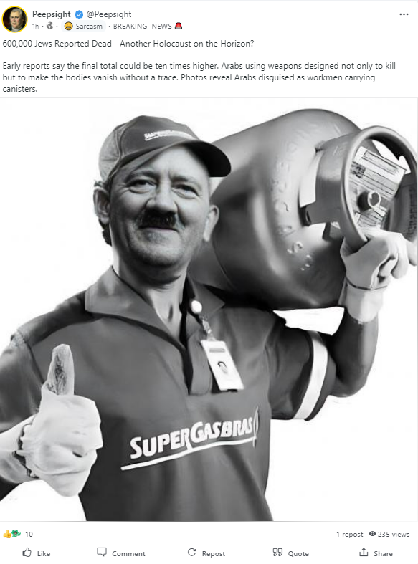
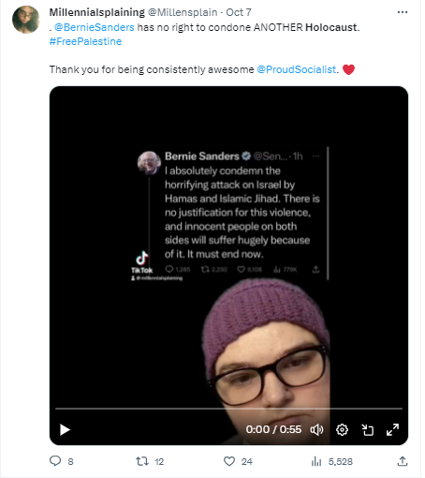
2) Misuse of the Holocaust to attack Jews
Gab
10/8/2023
X
10/7/2023

Slide 22


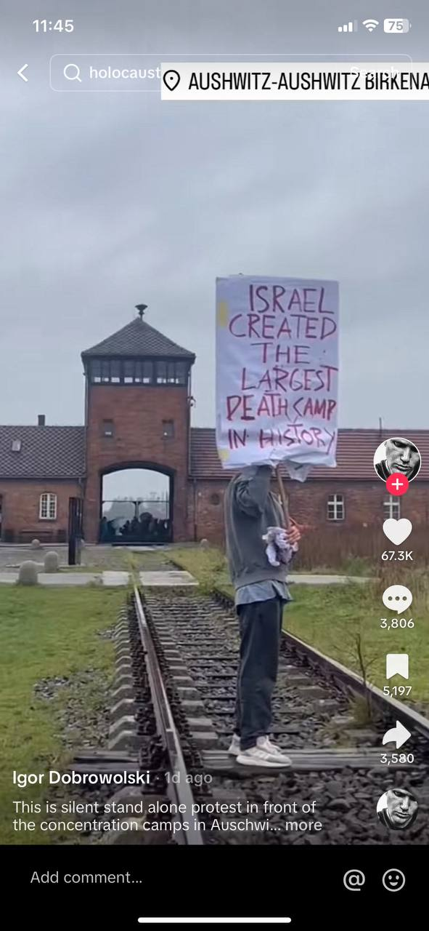
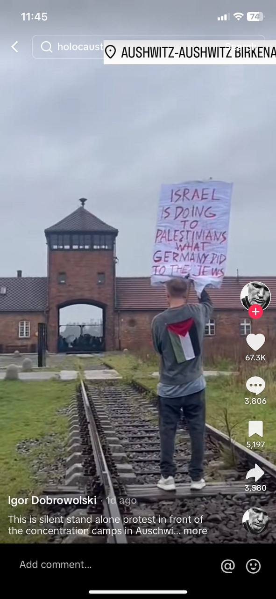
What happened online after 10/7 → Supporting and distorting the Holocaust
Platform: TikTok

Slide 23
3) Mainstreaming of the Genocide Accusation after 10/7

Slide 24
4) Posts on the Holocaust trigger Nazi-Israel comparisons Examples of comments on posts by
Yad Vashem and
USHMM

Slide 25
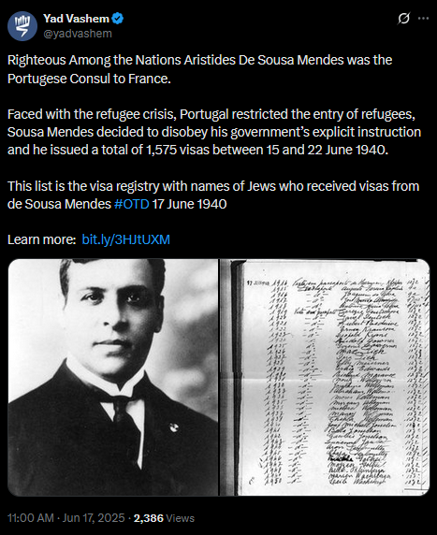
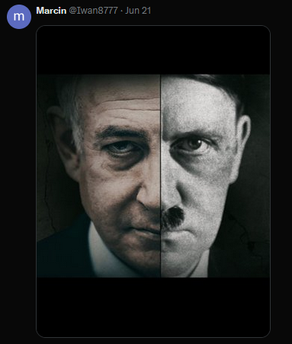
Yad Vashem posted this on X, June 17, 2025
This was one of the comments
The same user reposted a video celebrating the Iranian missile attacks on Tel Aviv. The user is a regular commentator on the Yad Vashem page, using the same image or other ways to equate Israel with Nazi Germany.

Slide 26
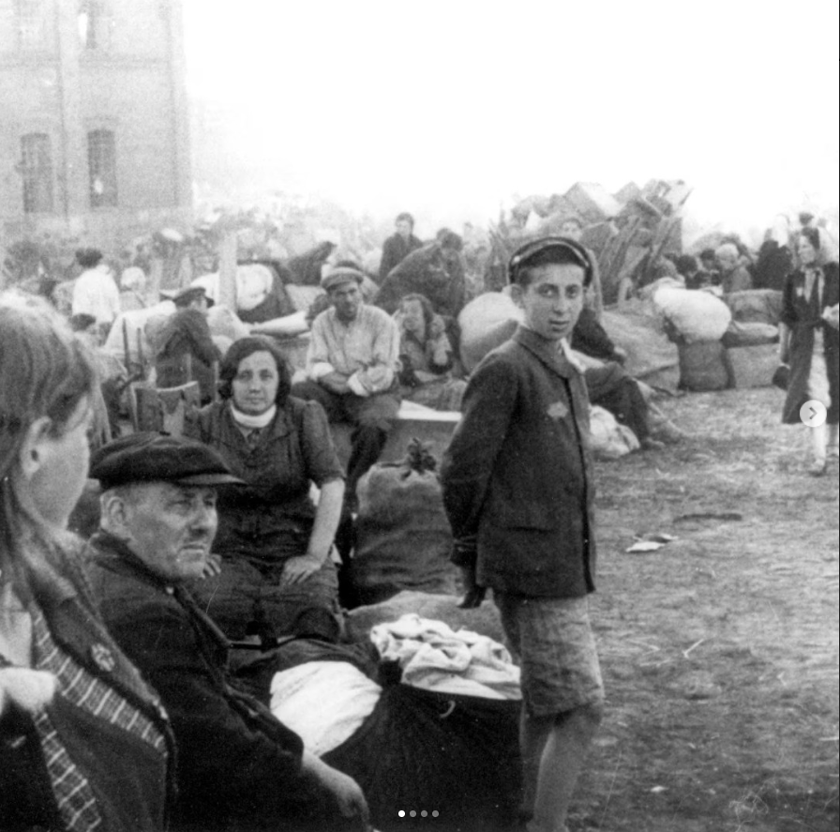


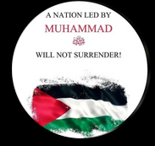
Yad Vashem posted this image on Instagram on June 3, 2025
This was one of the comments, equating the Gaza war with the Holocaust

Slide 27
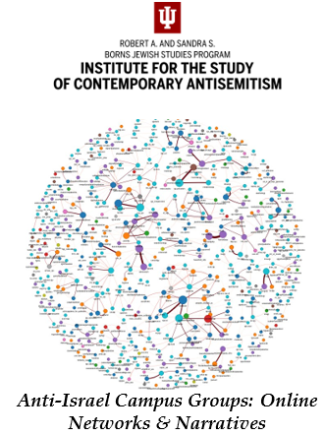

Some good news:
prominent social media opinions are not representative
Social Media amplifies extremes who tend to be more active → false impression that feeds are representative.
Nefarious organizations and foreign actors (Russian, Iranian, organizations linked to Palestinian terrorism) often influence the online discussions, including through bots.

